Slide 1


How to debug
Special Session 2

Slide 2
Overview
Formal theory
Reachability
Code coverage
Debugging tools
When and where to use
Debugging techniques
From basic to advanced
Examples
Practical part
Final discussion

Slide 3
Admin
Student participation is essential for this session
Please ask as many questions as possible
No past prac implementation will be covered but rather guidelines for future pracs will be discussed

Slide 4

Formal Theory
How can an algorithm be visually modeled?

Slide 5
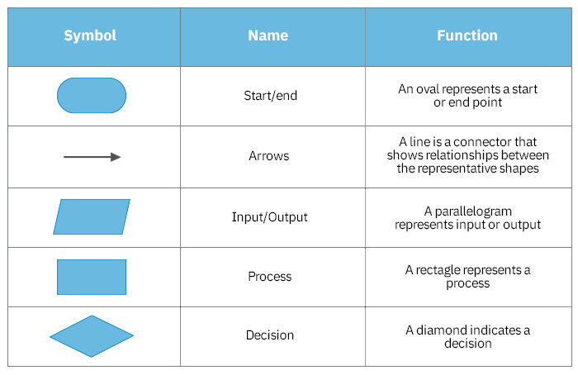
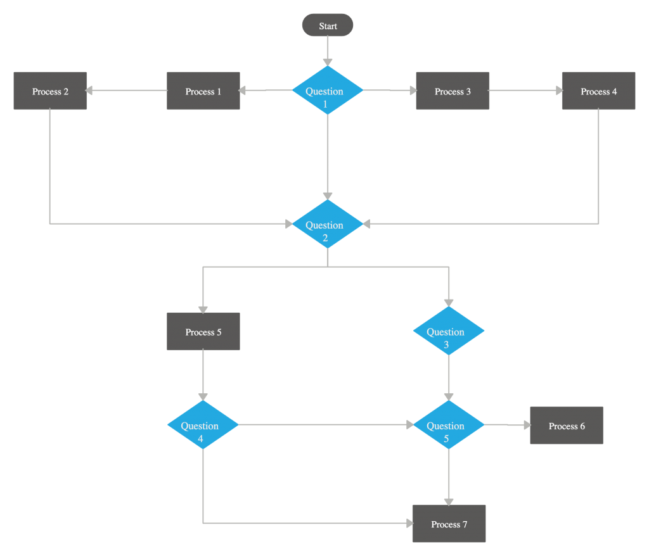
Flow chart

Slide 6
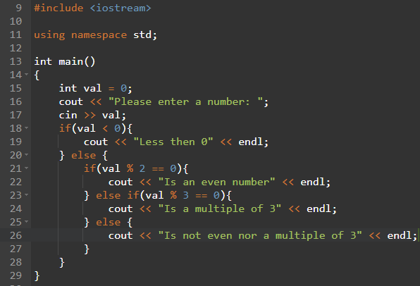
Excersice
Convert the following code to a flow diagram

Slide 7
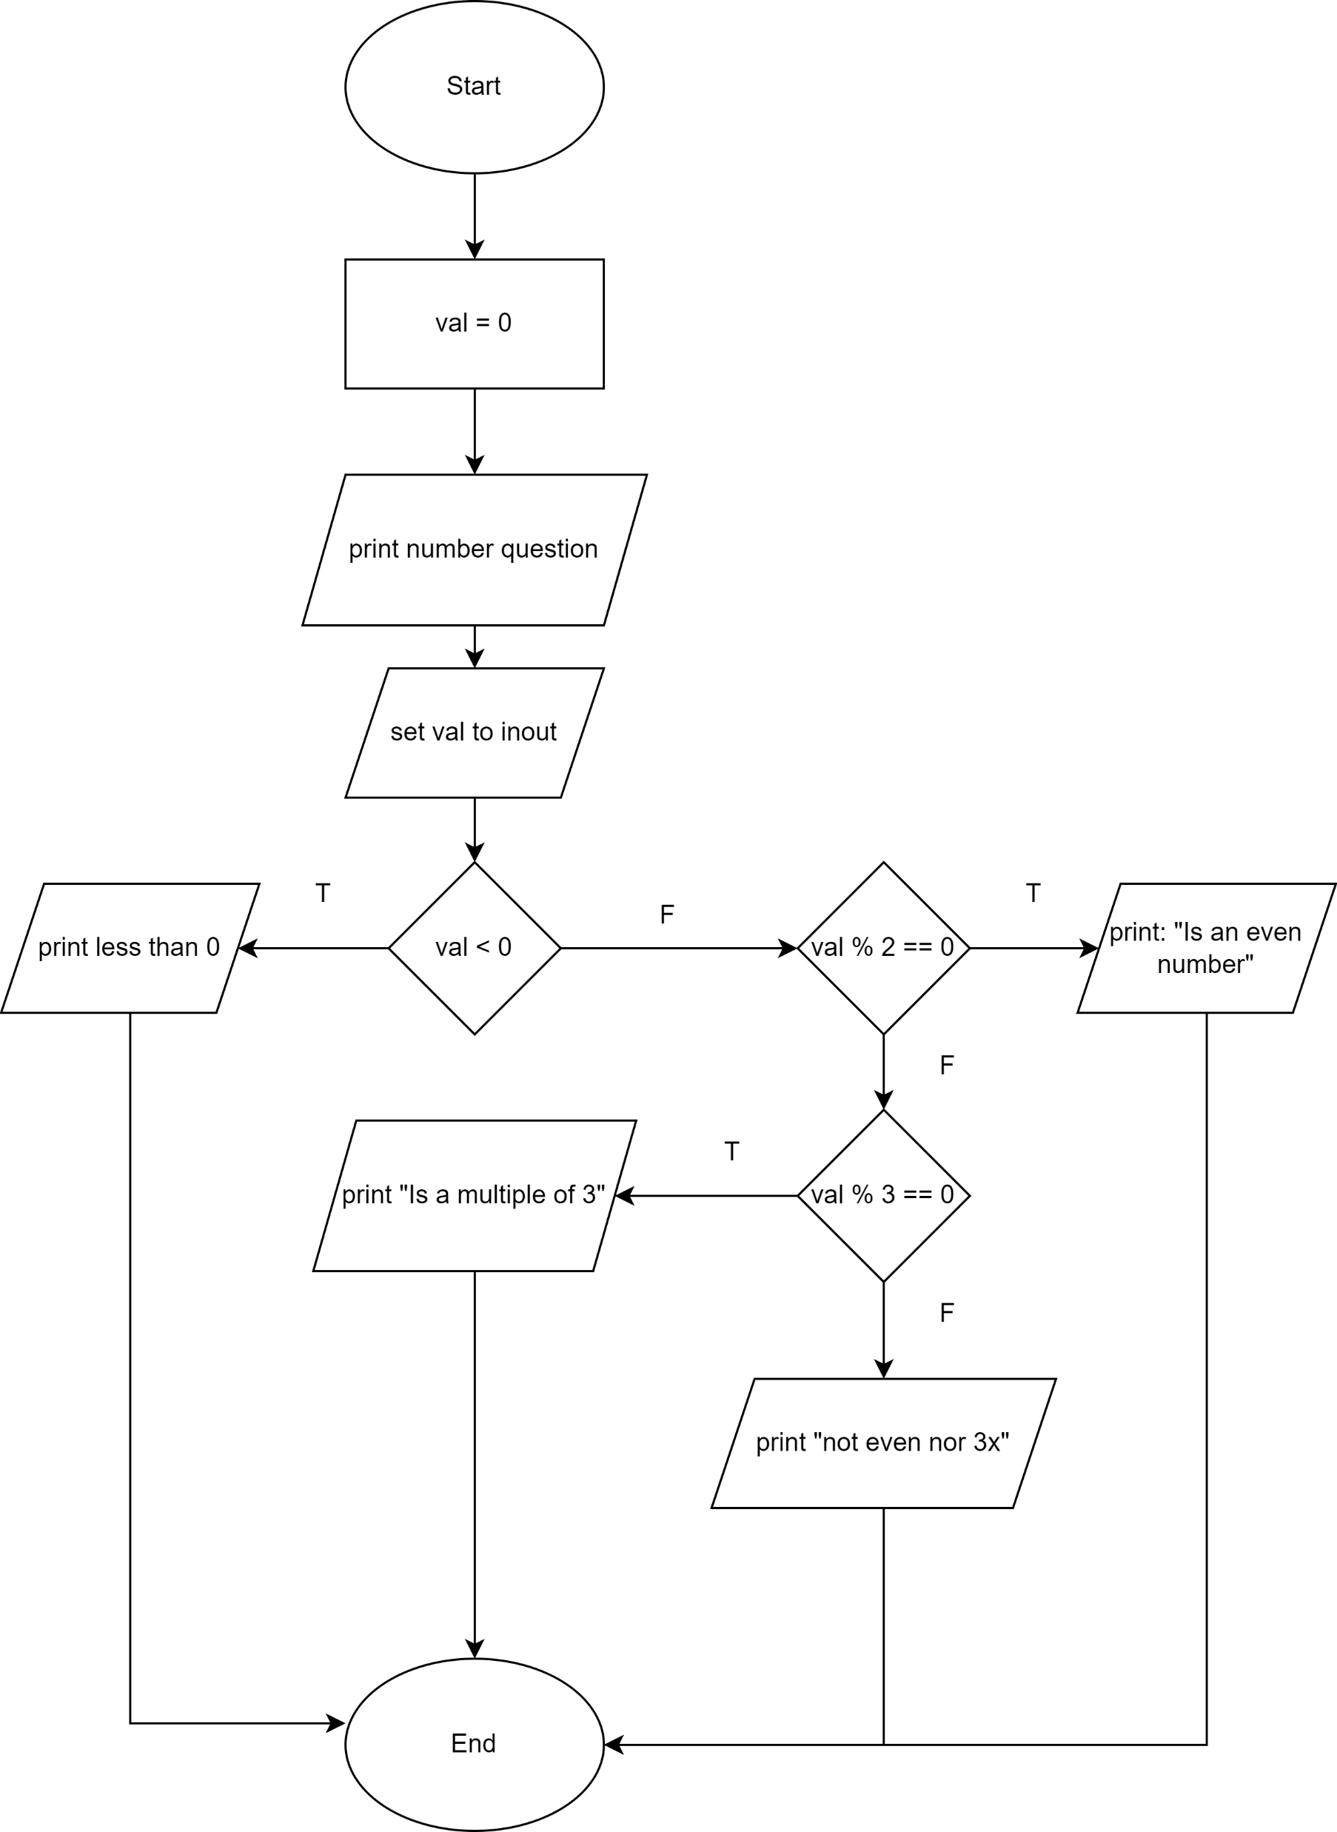
Solution

Slide 8
Formal theory
What is reachability?

Slide 9
Reachability
Location or locations in the program that contains faults must be reached
I.e. reachability is the set of values/conditions that need to be met such that a faulty location can be reached.
General tip:
If you can find the line that causes the error you should be able to figure out whats causing it and backtrack from there

Slide 10
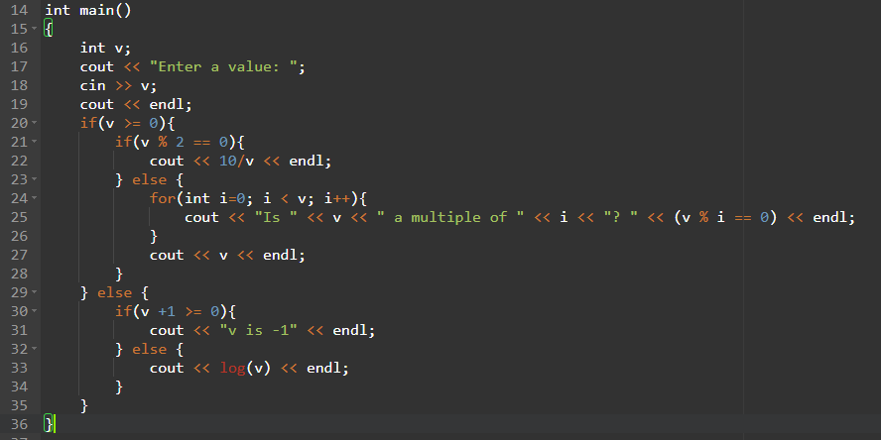
Reachability
During testing it is noted that the code crashes at line 25 with an arithmetic exception.
Under what conditions will line 25 be reached?

Slide 11
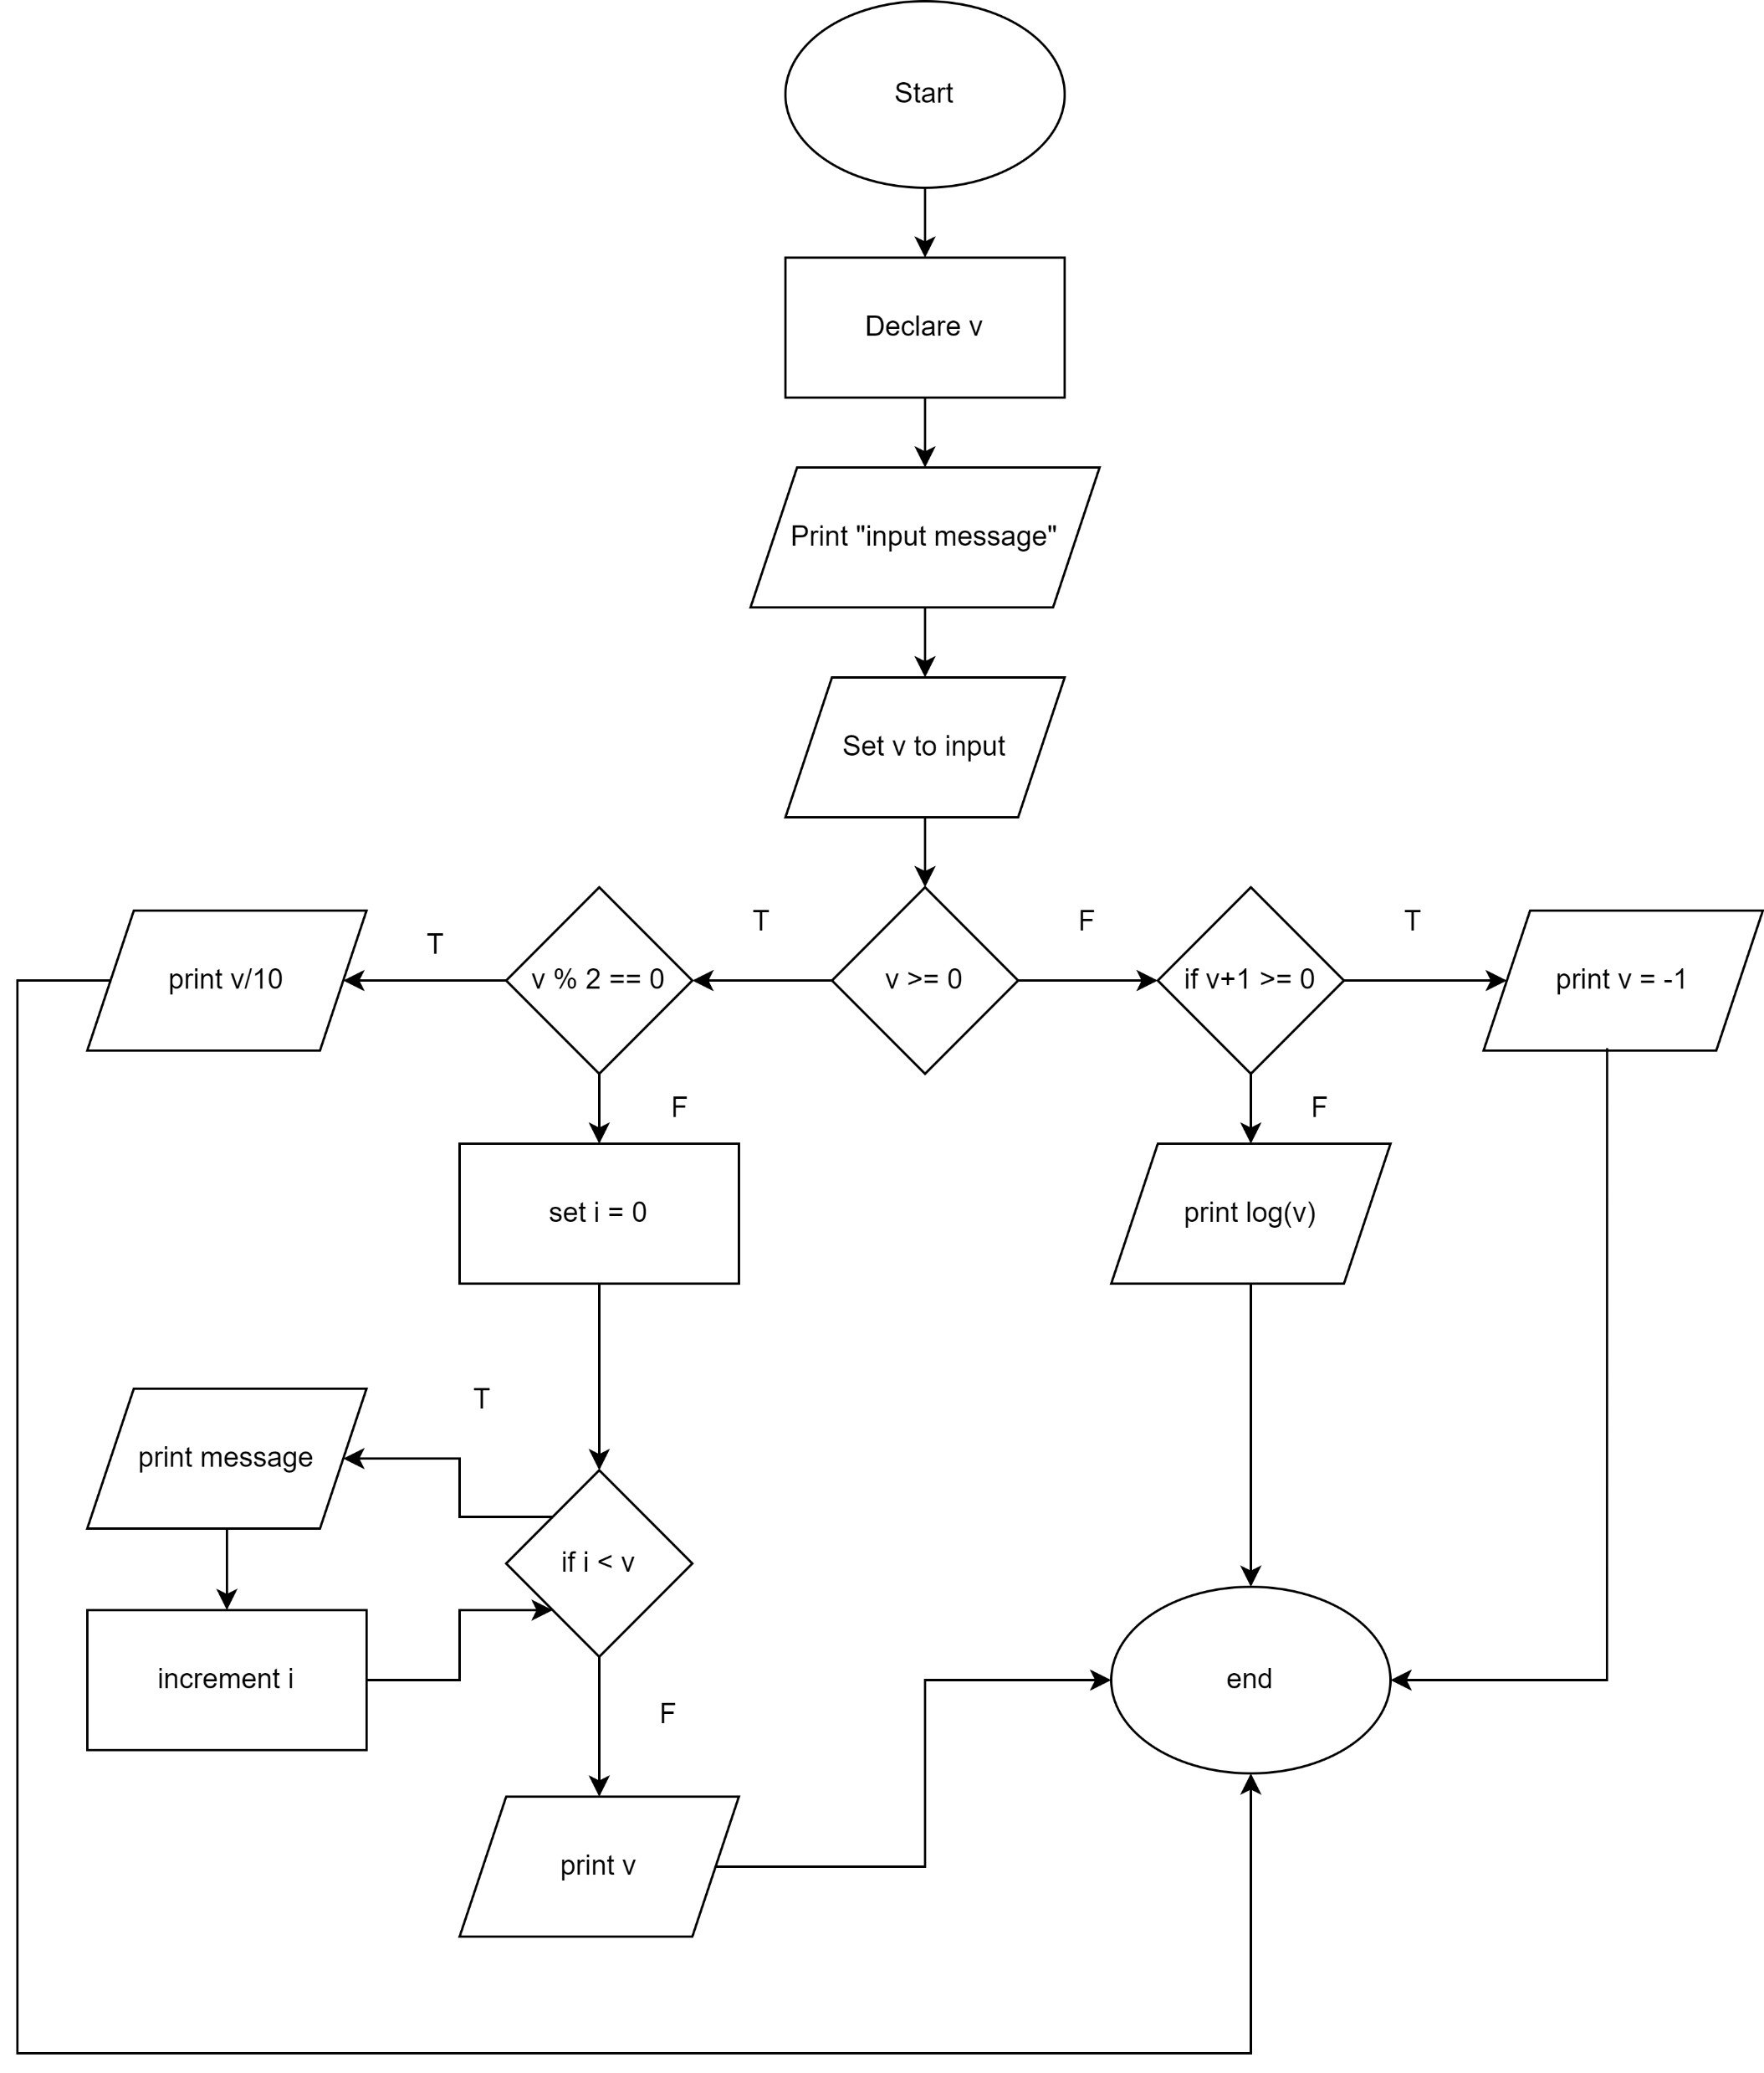
Before we answer let's make a flow diagram

Slide 12
Reachability
During testing it is noted that the code produces -nan. You determine it originated from line 33.
Under what conditions will line 33 be reached?

Slide 13

Code coverage
What is code coverage?

Slide 14
Code coverage
This is a metric used to describe the number of lines that was executed during testing.
Advanced project tools track this for you during testing phases.
Why is this important?
Checks to see if every possible flow in a program has been executed atleast once.
Does a high code coverage mean the code is without fault?
Unfortunately, not.

Slide 15
Tip for testing and debugging
Think of your code as a flow diagram (which in essence it is)
Make sure you test each branch and possible path you can in the flow diagram
Testing using a model of the system is known as Model Checking
COS 741 (Dr Timm)
Why does this help
Makes it easy to understand the conditions that is causing the system to fail
Visual path through your code
Forces linear thinking

Slide 16

Debugging tools
When to use GDB?
When to use Valgrind?

Slide 17
Debugging tools
GDB:
Any errors like seg faults, exceptions and double free
Backtrace shows the path that the program took to get to the error
Demoed a bit later
Valgrind
Usually for memory leaks or any memory related errors
Usually for most cases GDB will be able to detect the memory related errors

Slide 18

Debugging techniques
Easy to Adv

Slide 19
Debugging techniques
Print statements
GDB
Break points
Conditional break points

Slide 20
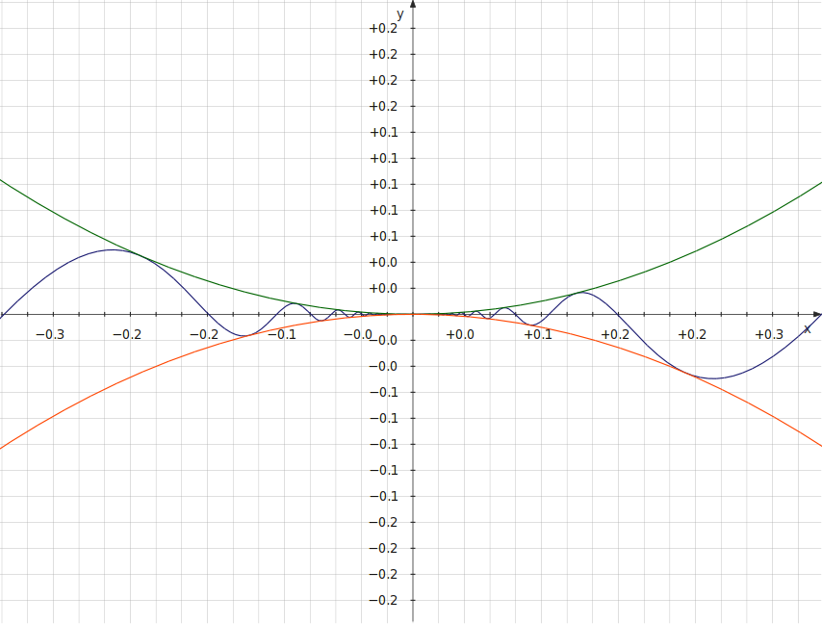
Print statements
Most primitive form of debugging
Purpose?
See the values of variables
Try and narrow down the error prone line
Debugging squeeze theorem
Who has heard of the squeeze theorem from WTW?
Basic idea:
An unknown function bounded between an upper function and a lower function.
Then for any x the value of the unknown function must be between the value of the upper and lower function for the same x.

Slide 21
Print statements
How is the squeeze theorem useful?
Put a cout at the top of your code
Put a cout at the bottom of your code
Move the top down to the bottom one line at a time
When top line disappears, u found the faulty line
Pros:
Guaranteed
Minimal skills needed
Cons:
Time

Slide 22
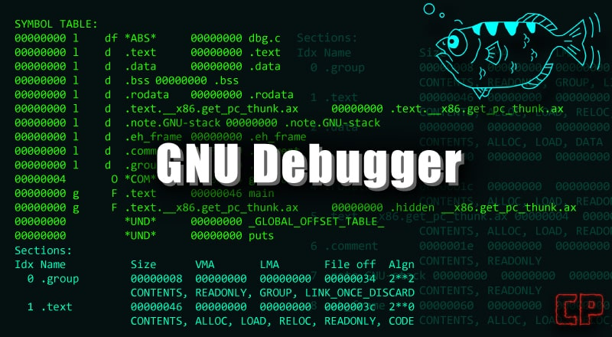
GDB
Terminal based debugger
Able to:
Add break points
Back trace errors
Print out variables (*)
Etc
Most common used to find errors:
Given that the executable is main
gdb main
//gdb will open
run
//the code should run and crash if a faulty flow is hit
bracktrace
This will be demoed later

Slide 23
Break points
What are they?
A point in the code where execution is halted in such a way that analysis can be performed, and the execution can be continued in a controlled manner.
Why are they useful?
Lets you see the values of parameters
Monitor program flow
GDB has the ability to add break points
Painful to do and I will leave it for 284
Demo with vs code later

Slide 24
Conditional Break points
What is a condition?
Something that can be true or false
What is a conditional break point?
A break point that will only halt the execution if the condition is met
Why is this useful?
Allows to execution of code to halt under a certain condition
Examples of where this will be useful
Loops

Slide 25

To the code examples we go

Slide 26
Practical component

Slide 27
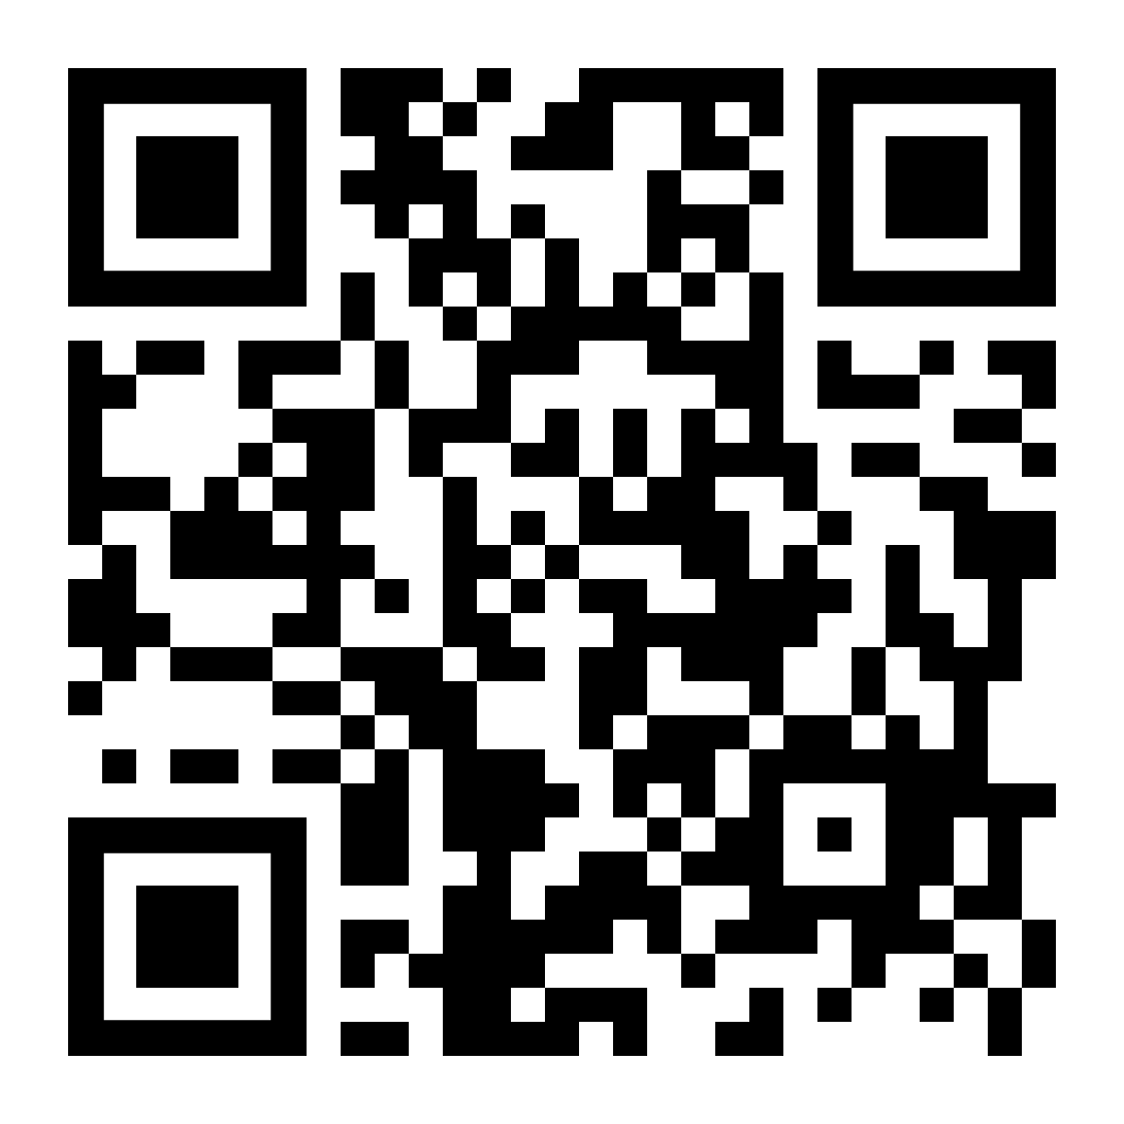
Instruction
https://forms.gle/Ndpporw5Uae52c5a7
Break into groups of 5
Go to optional practical 3 on FitchFork
Each of the indicated functions has 1 error
If only that was the case in real life
There are 10 faulty functions
Suggested
Each person tried to solve 2 functions
Fill in the google form
First team to correctly find all 10 errors will win the competition
Prizes will be announced later (probably bragging rights)

Slide 28

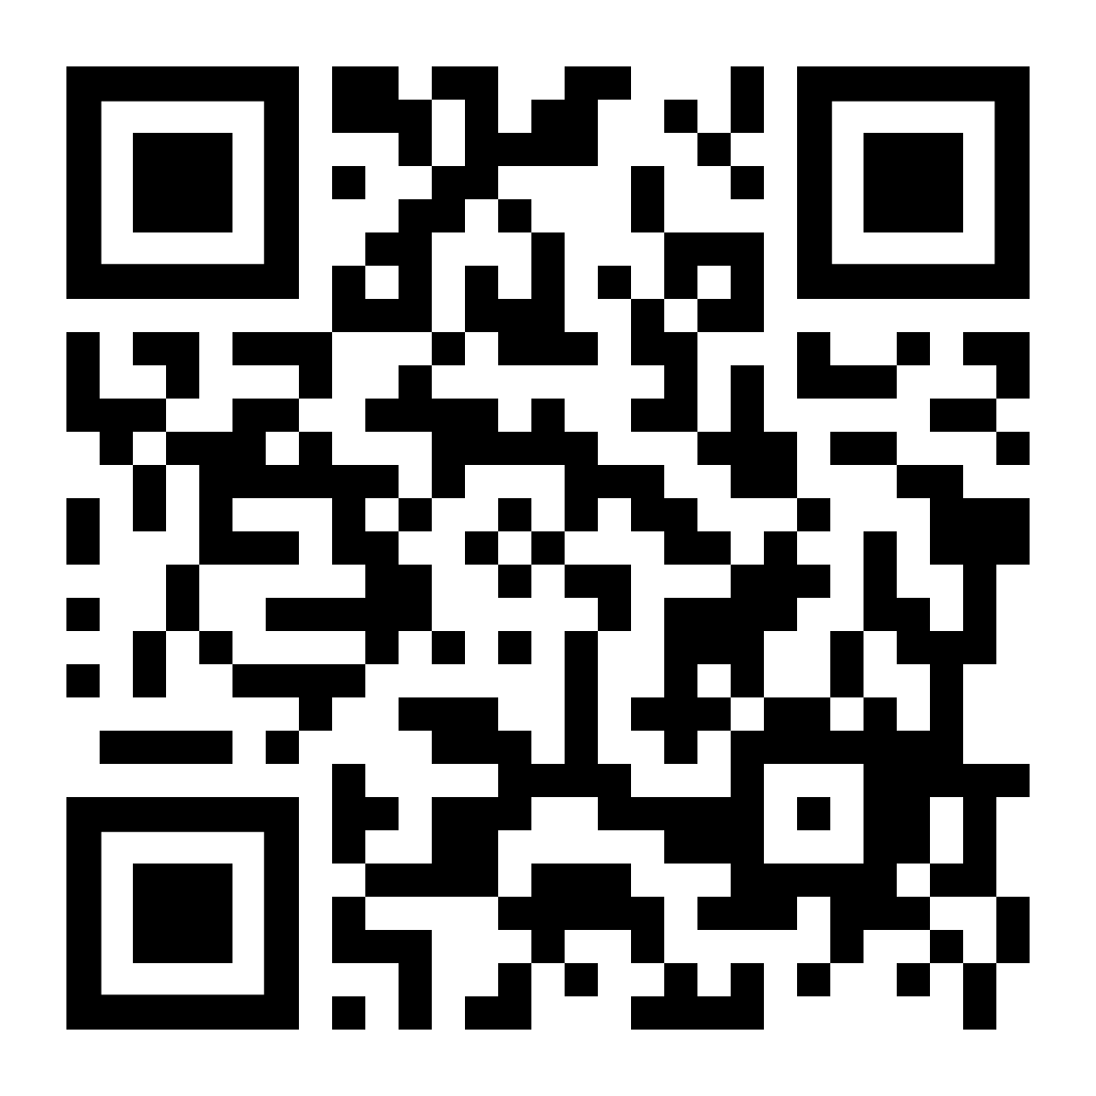
Final questions
https://forms.gle/LTKPVdduqUBAuZu69

